Slide 1
Image classification
Lahari s.k
Data science- intern
Flip robo technologies

Slide 2
Contents
Image scrapping
Image classification

Slide 3
INTRODUCTION
Image classification is growing and becoming a trend among technology
developers especially with the growth of data in different parts of industry such as e-commerce,
automotive, healthcare, and gaming.

Slide 4
Image scrapping
In this particular project we have to collect data of minimum 200 images of
categories like
a) Saree
b) Pants(Men)
c) Trousers(Men) from the amazon website.

Slide 5
Libraries used
Pandas
Numpy
Selenium
Shutil
Requests
OS
Time
Steps

Slide 6
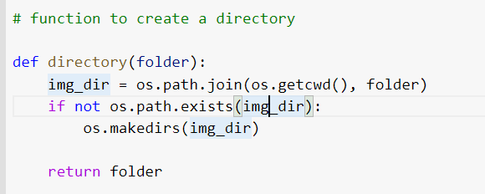
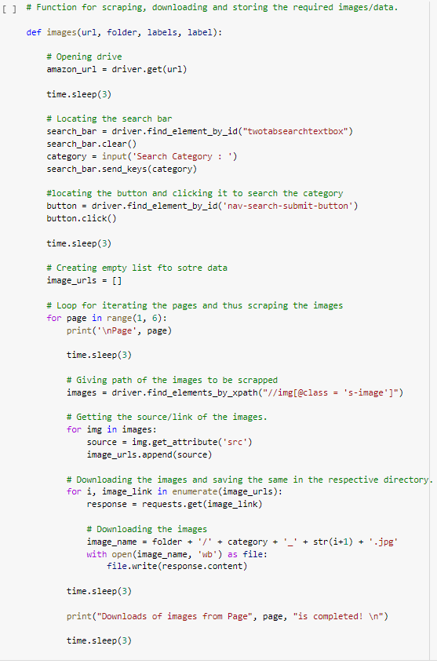
Code snippet for image scraping

Slide 7
“images” is the function that we are creating to scrap all the images we are
defining 4 parameters inside the function namely
1.url=url of the website to be scrapped
2.folder=folder name where we need images to be saved
3.labels=variable to specify output constraint
4.label=assigning different values to different categories
amazon_url contains the url that has to be searched. search_bar is used to
send the keys of the input . button is used to search the entered product.
We are scrapping first 6 pages of the website.image names is created by
concatenating the folder name,category ,number and jpg extension.Now the
images is saved file.

Slide 8
Image classification
Libraries used
tensorflow
keras
PIL
Image
kerastuner
RandomSearch
Hyperparameters
matplotlib

Slide 9
Images are read from the folder using Image.open.Since all the images are of
different ssizes ,resize is used to normalize or scale all the images into same
size.
The data is loaded read from the csv file.We are using simple cnn archirectue
with keras tuner to solve the problem.
Sequntial layer is created which is consisted of 14 layers.One input layer,1
output layer,4 convolution layers,4 maxpooling layer,5 dropout layer to
overcome overfitting.

Slide 10
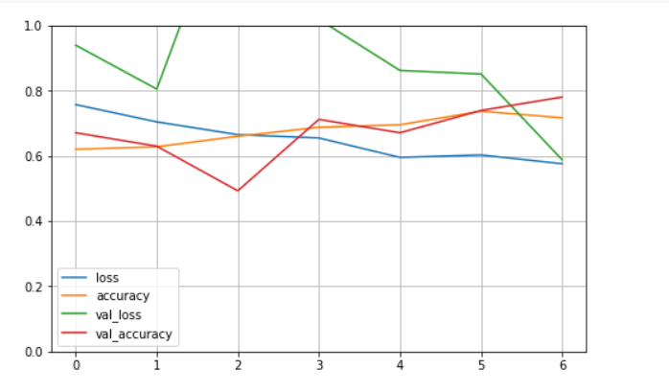
Results
The results areas follows
Training accuracy: 71.14 with loss: 0.572
Validation accuracy: 78.8 with loss:0.58
Test data accuracy: 0.75 with loss:0.57

Slide 11
Thank you

